Slide 1
Content Based Image Retrieval
Group 11

Slide 2
Barcode Generator

Slide 3
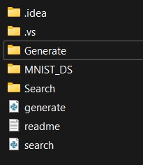
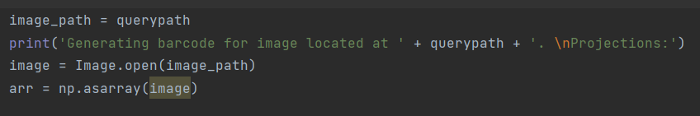
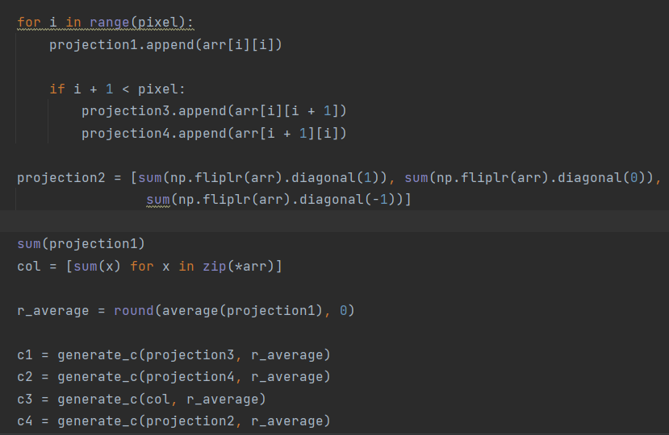

Slide 4
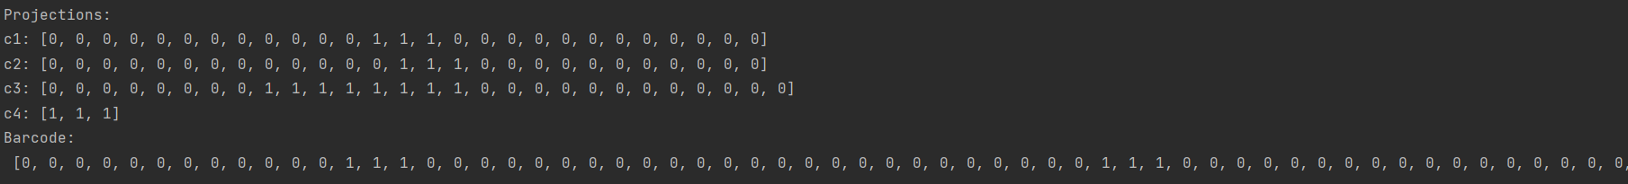
Output

Slide 5
Search Algorithm

Slide 6
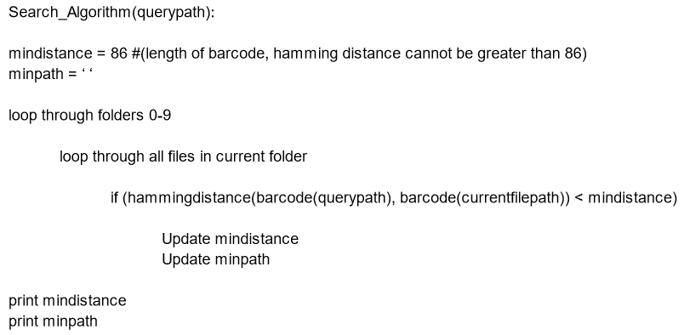
Search Algorithm Pseudocode

Slide 7
Measurements and Analysis

Slide 8
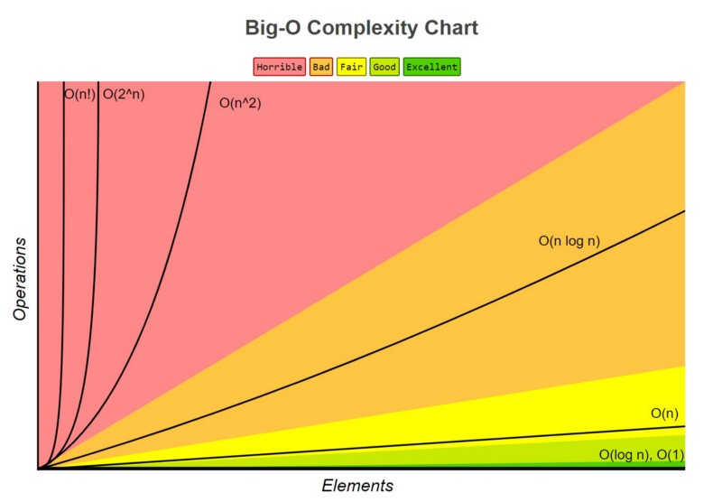
Time Complexity
Barcode Generator
Runs in the same time and space
Input size is the same > O(1)
Search Algorithm
Run-Time depends on size (n) > O(n^2)

Slide 9
Improvements

Slide 10
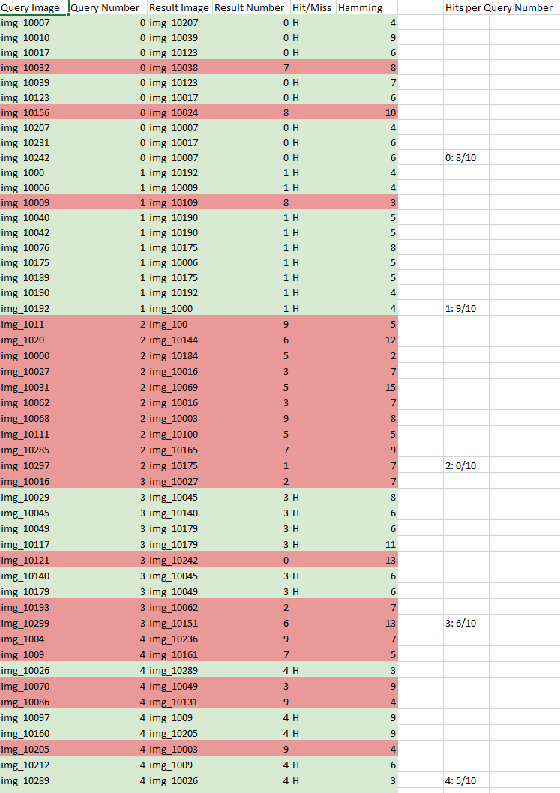
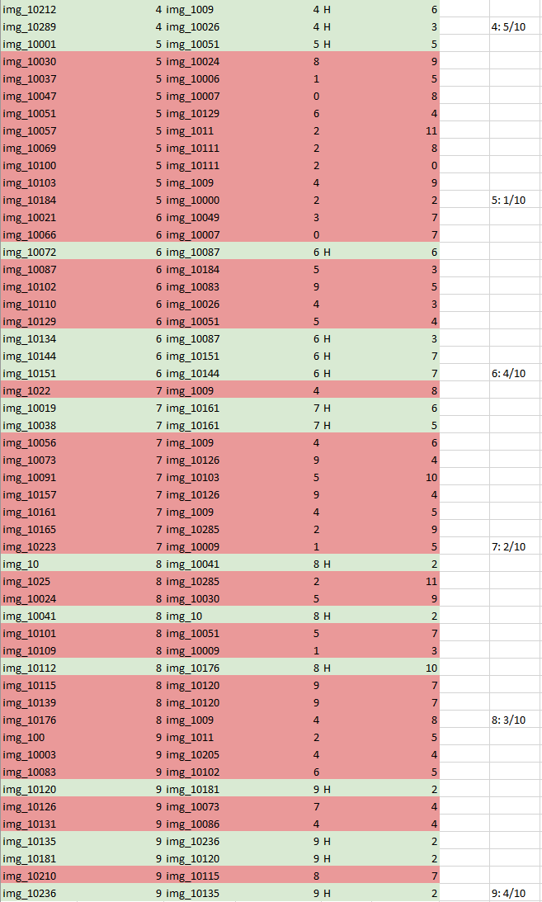
Improvements
Hit Ratio: 42%
Only 4 projections: increase
Improve hamming distance

